Slide 1
Economic Policy and Business Activity
Chapter 3
Fiscal policy

Slide 2
3. Fiscal policy
3.1 Issues
3.1.1 What is it all about?
3.1.2 Lessons from history
3.2 Theories
3.2.1 Demand-side effects: Keynes and his critics
3.2.2 Public debt sustainability
3.2.3 Supply-side effects and reconciliation attempts
3.3 Policies

Slide 3
Next class
- public debt dynamics & public debt sustainability calculus and indicators
- some main theories underlying demand and supply side effects of fiscal policies
Today
- Fiscal policy and economic functions of government
- Fiscal balance and its main components

Slide 4
Learning outcomes (#1)
Explain the main objectives of the fiscal policy and relate it to government’s economic functions
Explain the differences in the temporal dynamics of FP and MP
Define public budget and fiscal balance
Explain the different components of the fiscal balance (e.g. financial vs primary balance; cyclical vs structural balance; OECD’s “underlying fiscal balance”)

Slide 5
Learning outcomes (#2)
Explain the main ways of financing public deficits
Define public debt, net public debt and gross public debt
Explain the key elements of public debt dynamics
Define public debt (in)solvency
Describe the options available to countries in a situation of public debt insolvency
Describe the main indicators used to assess public debt sustainability

Slide 6
Learning outcomes (#3)
Explain the main features of the Keynesian macroeconomic approach
Explain the Keynesian multiplier
Explain the main factors that affect the Keynesian multiplier and the effectiveness of fiscal policy
Explain the main neoclassical criticisms to the Keynesian multiplier
Explain the points of agreement and disagreement between Keynesians and neoclassical economists
Understand the non-Keynesian effects of fiscal policy

Slide 7
Fiscal policy (FP)
FP can simultaneously fulfil the three functions of allocation, stabilisation, and redistribution
However, Fiscal policy usually refers to the stabilisation function: it is aimed primarily at changing income and employment in the short run
  “the set of decisions or rules regarding taxes and public expenditures for purposes of dampening the fluctuations of the economic cycle in order to keep unemployment close to its equilibrium value and thus avoid the build-up of deflationary or inflationary pressures”

Slide 8
Fiscal policy
FP emerges as a XXth invention that owes considerably to the thinking of John Maynard Keynes
FP owes even more to the general rise of the share of public expenditures in GDP as a consequence of the generalization of government finances of social insurance, welfare, and education - since World War II, governments in all countries have thus been transformed from an irrelevant macroeconomic player into a major contributor to aggregate demand
After the 2008 financial and economic crisis, fiscal policy regained attention as a key prescription of the policy response to the crisis via fiscal stimulus programs, followed by debates on public debt sustainability
The public policy responses following the covid19 pandemic are further evidence of the importance of fiscal stimulus to provide immediate responses to economic crisis

Slide 9
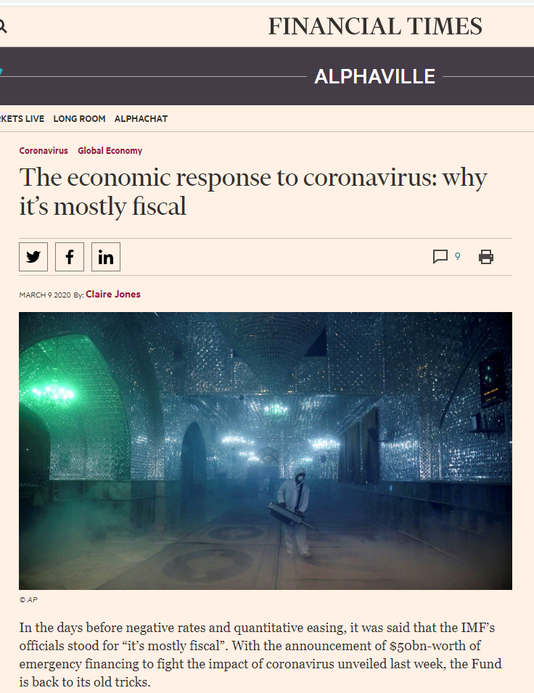
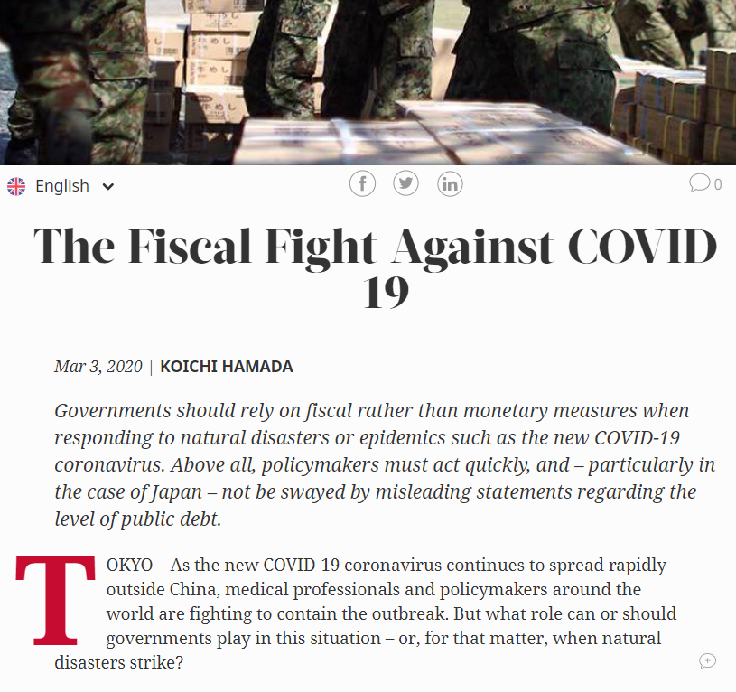
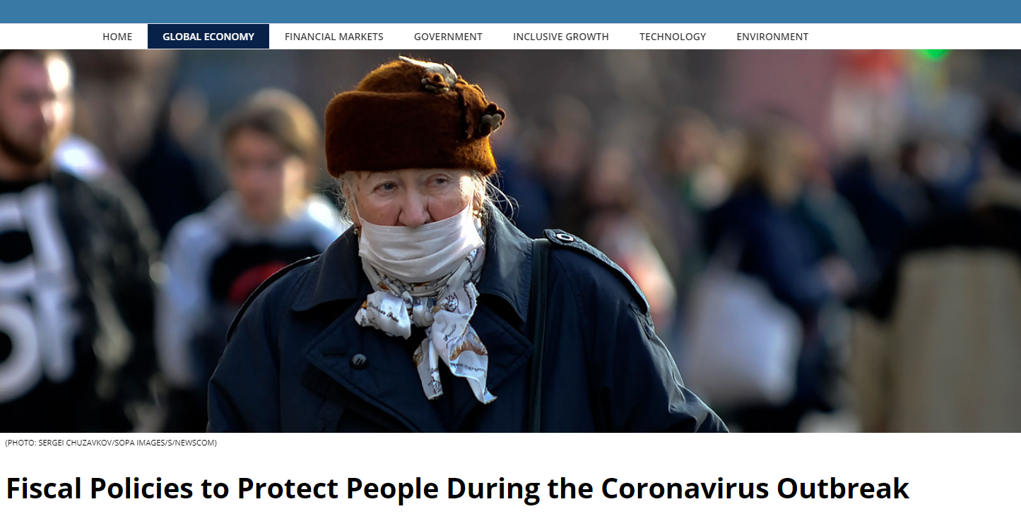
https://ftalphaville.ft.com/2020/03/06/1583518706000/The-economic-response-to-coronavirus--why-it-s-mostly-fiscal/
https://www.project-syndicate.org/commentary/governments-must-use-fiscal-policy-to-tackle-coronavirus-by-koichi-hamada-2020-03
https://blogs.imf.org/2020/03/05/fiscal-policies-to-protect-people-during-the-coronavirus-outbreak/

Slide 10
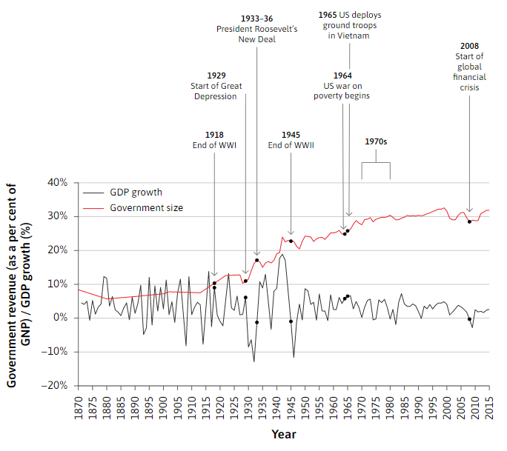
Fluctuations in output and the size of government in the US (1870–2015)
The big increase in the size of government after the Second World War was accompanied by a reduction in the size of business cycle fluctuations.
After 1990, the business cycle in advanced economies became even smoother, until the global financial crisis in 2008.
This led to the period from the early 1990s to the late 2000s being called the great moderation*.
*great moderation:
period of low volatility in aggregate output in advanced economies between the 1980s and the 2008 financial crisis. The name was suggested by the economists James Stock and Mark Watson and popularized by Ben Bernanke (was chairman of the Federal Reserve).
Unit 14 Unemployment and fiscal policy – The Economy (core-econ.org)
Notes:
The fact that the fluctuations in output growth dramatically reduced while the size of government expanded does not mean that increased government spending stabilized the economy (remember: statistical correlations do not mean causation). But there are good reasons to think that the increase in the red line was part of the reason for the smoothing of the black line. In this unit, we ask why the increased role of the government in the economy is part of the explanation for the more stable economy in the second half of the twentieth century.

Slide 11
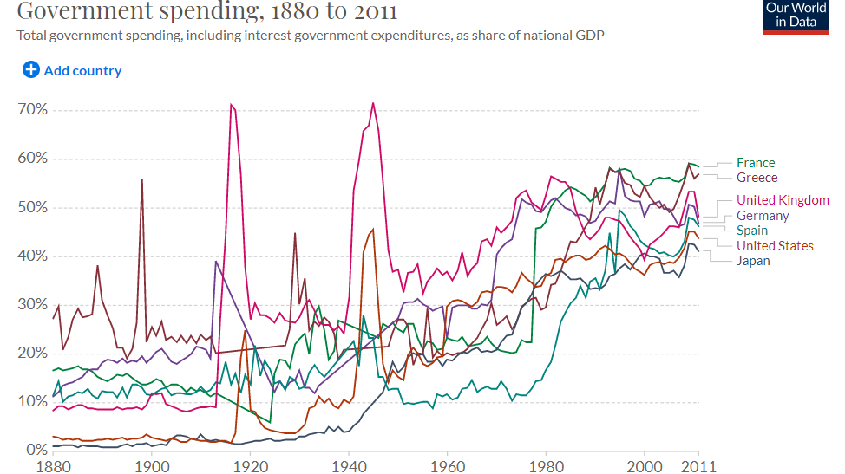

Slide 12
How can governments manage economic fluctuations using fiscal policy?
The increased role of the government in the economy is one of the explanations for the more stable economy in the second half of the twentieth century, i.e. fewer fluctuations.

Slide 13
How can governments manage economic fluctuations using fiscal policy?
By influencing aggregate demand through public spending.
Public spending on consumption and investment is generally more stable and less subject to market volatility compared to private investment.
Public spending fluctuates less with capacity utilization and business confidence, and thus can be more effective at stabilizing the economy.
Governments also use public spending to directly reduce the negative impacts resulting from job loss and income loss through e.g. unemployment benefits, tax credits, financial stimulus packages, etc.

Slide 14
- The size of government: Unlike private investment, government spending on consumption and investment is usually stable. Spending on health and education, which are the two largest government budget items in most countries, does not fluctuate with capacity utilization or with business confidence. These kinds of government spending stabilize the economy. A higher tax rate (i.e. progressive taxation) dampens fluctuations because it reduces the size of the multiplier (next class).
- The government provides unemployment benefits: Although households save to smooth fluctuations in income, few households save enough (that is, self-insure) to cope with an extended period of unemployment. So unem­ployment benefits help households to smooth consumption. Other pro­grams to redistribute income to the poor have the same smoothing effect.
- The government can intervene: It can intervene deliberately to stabilize aggregate demand using fiscal policy.
Three main ways that government spending and taxation can dampen fluctuations in the economy:

Slide 15
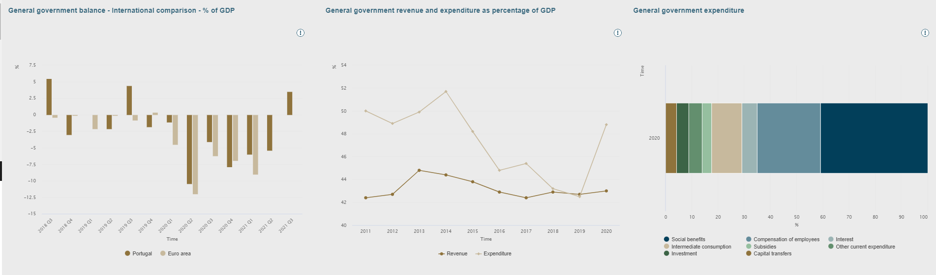
Portugal
https://bpstat.bportugal.pt/dominios/172

Slide 16
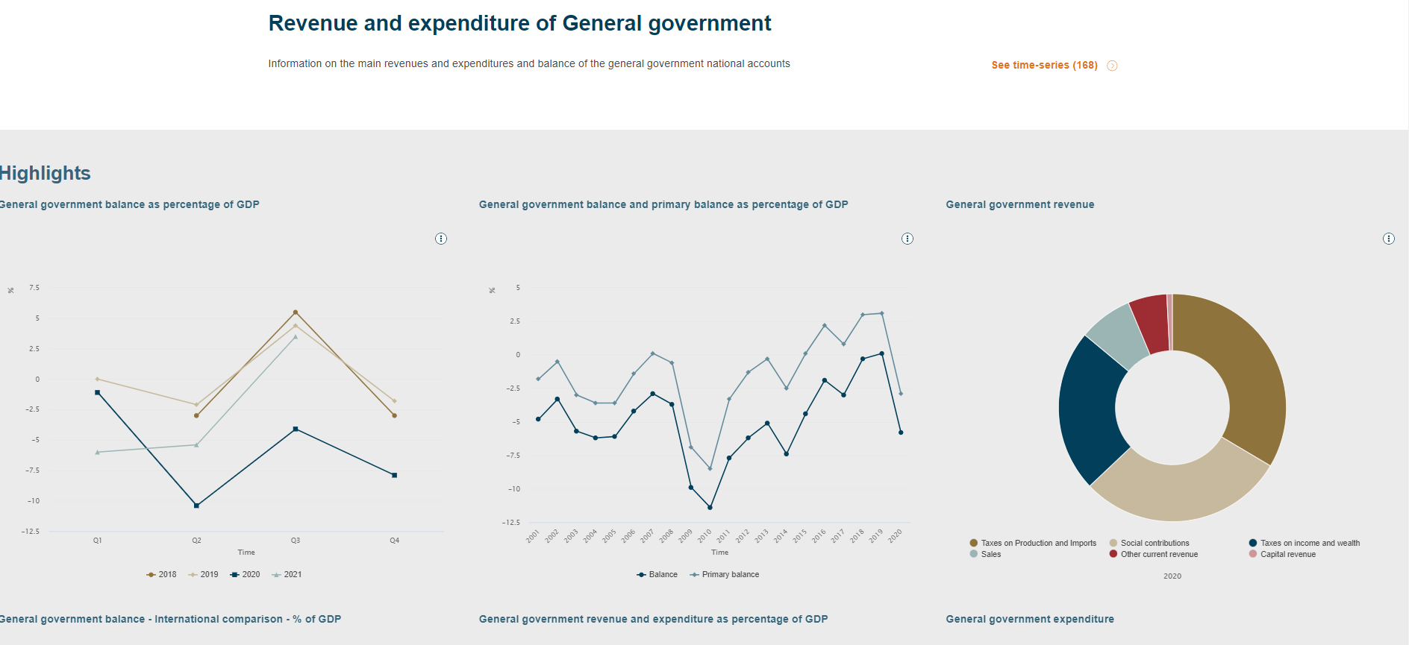
Portugal
https://bpstat.bportugal.pt/dominios/172

Slide 17
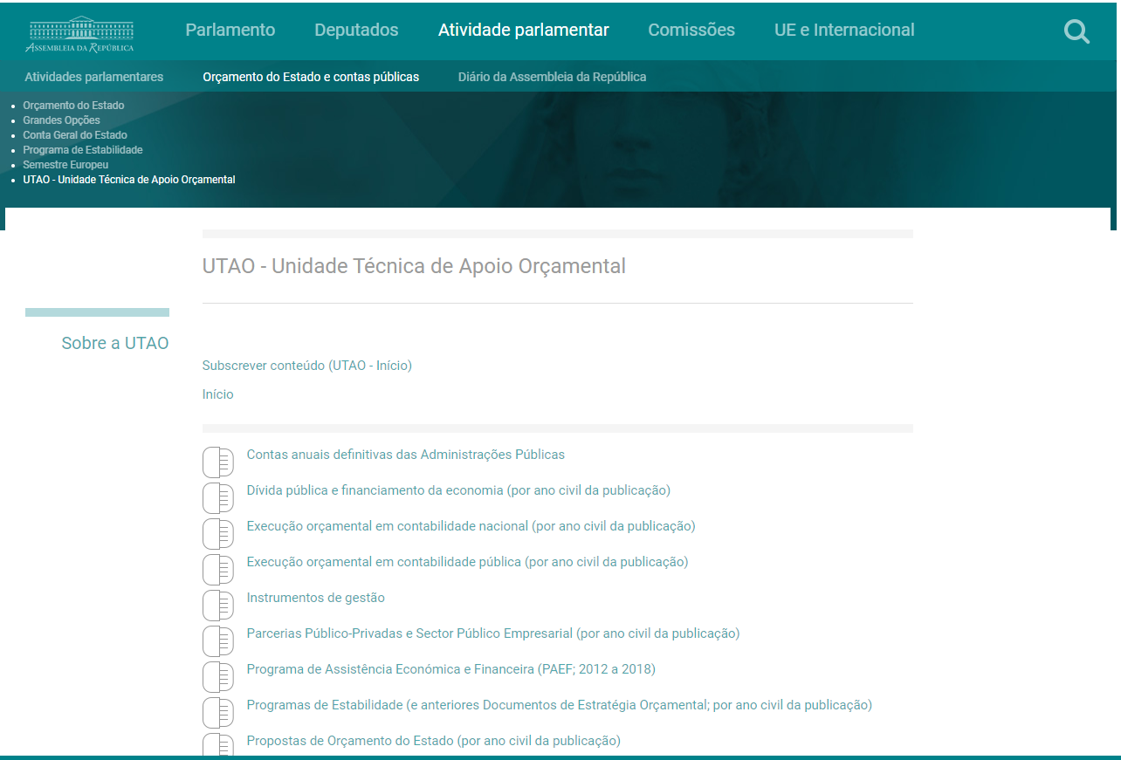
Portugal
Government Budget
https://www.parlamento.pt/OrcamentoEstado/Paginas/UTAO_UnidadeTecnicadeApoioOrcamental.aspx

Slide 18
The fiscal balance
The fiscal balance is the difference between revenue (R) and expenditure (E):
There is a fiscal (or budget) surplus when the balance is positive: R-E>0
There is a fiscal (or budget) deficit when the balance is negative: R-E<0
where:
R: Government revenue
E: Government expenditure

Slide 19
The fiscal balance
Financial balance
Primary balance
Structural balance

Slide 20
Portugal
https://bpstat.bportugal.pt/dominios/172

Slide 21
Measuring the fiscal balance (1)
Total or global fiscal balance (called net lending or financial balance) is the difference between the revenue and expenditure of public sector
The financial balance represents the borrowing need of the government and includes the interest paid on public debt
Interest charges depend on the debt level and on long-term interest rates, two variables which in the short term are not in governments’ hands

Slide 22
Interest and debt

Slide 23
Measuring the fiscal balance (2)
A better indicator of the deliberate fiscal action of government and of parliament is the primary balance: financial balance excluding interest payments on public debt (i.e. the fiscal balance if there was no public debt)
It is a better indicator of government fiscal action because the charges with interest on public debt result from the successive accumulation of fiscal deficits in previous periods and hence is not a direct consequence of the current government actions
Therefore, the global or total fiscal balance is NOT a good indicator of the current government deliberate or discretionary actions/decisions
Portugal
https://bpstat.bportugal.pt/dominios/172

Slide 24
Measuring the fiscal balance (3)
A general pattern of fiscal balances is that they tend to rise when economic activity booms and to decline when it is slowing down. This is because most tax bases move in line with economic activity (e.g. VAT revenues depend on final consumption), whereas some components of public spending (e.g. unemployment benefits) slowdown in economic booms
This spontaneous or automatic variation of fiscal balances is known as the automatic stabilizers: automatic stabilizers offset fluctuations in economic activity without direct intervention by policymakers
We call them “stabilizers” because they flatten the economic cycle by stabilizing the effect on households of changes in aggregate income – e.g. taxes paid, net of social transfers, increase during economic expansions, while the reverse occurs during downturns through unemployment benefits, without any policy change (i.e. they help stabilize income and consumption levels)
Notes:
Automatic stabilizers are features of the tax and transfer systems that dampen the economy when it overheats and provide economic stimulus when the economy slumps, without direct intervention by policymakers.
Automatic stabilizers offset fluctuations in economic activity without direct intervention by policymakers. When incomes are high, tax liabilities rise and eligibility for government benefits falls, without any change in the tax code or other legislation. Conversely, when incomes slip, tax liabilities drop and more families become eligible for government transfer programs, such as food stamps and unemployment insurance that help buttress their income.

Slide 25
Measuring the fiscal balance (4)
In order to capture the effects of changes in government’s fiscal policy, it is useful to calculate a cyclically adjusted fiscal balance (called structural balance)
The structural balance measures what the financial balance would be if output was at its potential level (i.e. no output gap)
The change in the structural balance from one period to next is generally regarded as providing a measure of the discretionary component of fiscal policy because in contrast to changes resulting from the automatic stabilizers it results from a government decision
So, when you debates about the deficit, you should question if they are talking about the structural balance. That is the one that measures the discretionary component. However, the structural balance is difficult to calculate since it requires a calculation of potential output, a notoriously fragile notion.
Notes:
O Saldo orçamental estrutural é o saldo “que existiria se uma economia estivesse no seu potencial ou na sua tendência de fundo (longo prazo), em torno dos quais a actividade económica vai flutuando para mais ou para menos (criando, assim, os ciclos económicos). Como o indicador pretende eliminar o efeito dos ciclos, para o calcular “é necessário estimar ou o produto potencial, ou a tendência de longo prazo”. E logo aqui que começam problemas: “Consoante é utilizado um ou outro conceito, assim o valor do SOE é diferente”.

Slide 26
Measuring the fiscal balance (5)
The evolution of the fiscal balance thus decomposes into:
a cyclical component independent of the government’s intervention, and
a discretionary component equal to the variation of the structural balance
The discretionary component provides a measure of the fiscal stance or attitude, i.e. of the orientation of fiscal policy
  Financial balance (net lending) =
  = cyclical balance + cyclically adjusted balance =
  = cyclical balance + structural balance
discretionary component of fiscal policy = variation of the structural balance
independent of government’s will= changes from the automatic stabilizers
Notes:
O Saldo orçamental estrutural é o saldo “que existiria se uma economia estivesse no seu potencial ou na sua tendência de fundo (longo prazo), em torno dos quais a actividade económica vai flutuando para mais ou para menos (criando, assim, os ciclos económicos). Como o indicador pretende eliminar o efeito dos ciclos, para o calcular “é necessário estimar ou o produto potencial, ou a tendência de longo prazo”. E logo aqui que começam problemas: “Consoante é utilizado um ou outro conceito, assim o valor do SOE é diferente”.

Slide 27
Measuring the fiscal balance (6)
The structural balance is the main indicator used by economists to analyse government’s fiscal policy
We can also combine the two decompositions of the deficit (financial/primary, financial/structural) to calculate a structural primary balance:
Financial balance (net lending) =
= cyclical primary balance + structural primary balance + interest payments on public debt

Slide 28
Measuring the fiscal balance
The primary and structural balances include a number of non-recurrent, one-off fiscal operations such as privatizations (or bank bailouts). These one-off operations undermine the accuracy of structural balances as indicators of the fiscal stance
Thus, to have a more accurate measure of the fiscal balance, the OECD introduced in 2008 a new indicator - the “underlying fiscal balance” - which measures the cyclically adjusted fiscal deficits adjusted for one-off operations. In the same spirit, the OECD also publishes underlying primary fiscal balances
Fiscal balance (net lending) =
= cyclical primary balance + one-off operations + underlying primary balance + interest payments on the debt
Notes:
underlying balance represents the fiscal balance as reported in the System of National Accounts (SNA) framework adjusted for two factors: the state of the economic cycle (as measured by the output gap) and one-off fiscal operations

Slide 29
Source: IMF report for Portugal, 2019

Slide 30
Example of fiscal indicators for Portugal in 2018

Slide 31
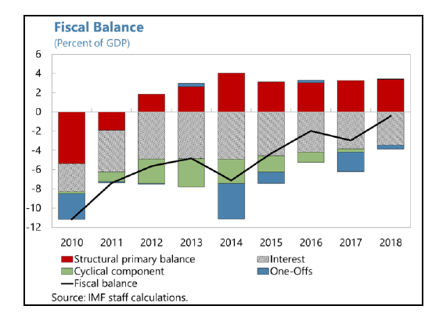
Recap: Measuring the fiscal balance
The fiscal balance shows the government’s net lending capacity (surplus) or net borrowing requirements (deficit).
It can be broken down into various components:
  total / primary
  cyclical / structural
  one-off operations
Budget deficit and public debt.

Slide 32
One important note on the measurement of public finances and the fiscal balance:
Public accounts system vs. National accounts system: whereas the public accounting system is oriented towards cash management, the national accounts system is designed for macroeconomic analysis and assessment.
Compliance with the fiscal discipline criteria laid down in the Maastricht Treaty (i.e., budget deficit below the 3% of GDP) is assessed according to national accounts. These figures are published by Statistics Portugal (INE) on an annual and quarterly basis, whereas public accounting figures are monitored by the Directorate-General for Budget (DGO) on a timelier basis.
Both accounting systems provide consolidated budget aggregates for the general government sector, but they lead to results that can be considerably different.
To obtain the national accounts balance from the public accounts finance, several adjustments and reconciliations are needed: e.g., sector delimitation; accrual accounting; etc.

Slide 33
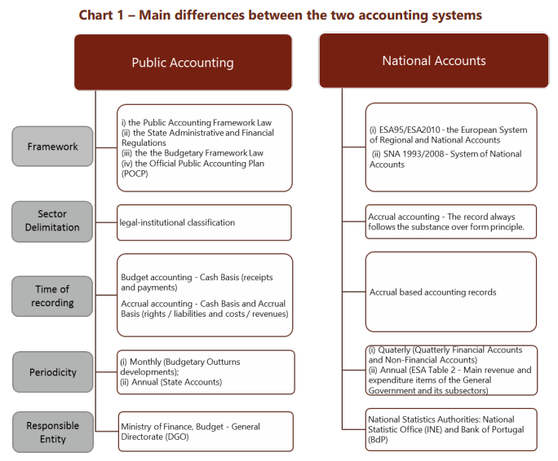
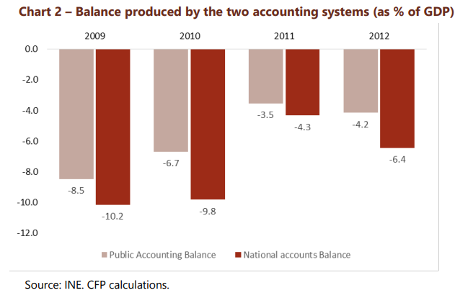
Note: For more information see, e.g., https://www.cfp.pt/uploads/publicacoes_ficheiros/cfp-notebook-no1-2014.pdf

Slide 34
How can governments finance fiscal deficits?
Raise taxes
Cut public spending
Sell national assets
Issue debt: Borrow from national and international investors (i.e. issue new debt)
5. Monetizing public deficit, or monetary financing, i.e. turning debt into money by having central banks buying government bonds directly
*notice the interactions btw fiscal policy and monetary policy
Notes:
Monetary financing – governments using their CB to finance public expenditure when they were unable or unwilling to raise the money on capital markets or by increasing taxes. https://www.intereconomics.eu/contents/year/2015/number/4/article/monetary-financing-in-the-euro-area-a-free-lunch.html

Slide 35
Financing public deficits
Leaving out the option of selling assets, deficits need to be financed by:
  borrowing from the national central bank (by creating money)
  borrowing from other public or/and private agents, including international organizations or foreign governments
The monetization of the deficit, or monetary financing, consists of a loan granted by the central bank to the government that increases the money supply. This mechanism can be a powerful source of inflation.
The link between monetary deficit finance and inflation has led to restrictions on how governments can borrow from their central bank. e.g. in EU, there are rules that forbid the ECB from engaging in monetary financing of national budget deficits. But, special times call for exceptions to the rules…post 2008 financial crisis, covid-19 pandemic [central bank buys debt off the market (quantitative easing/private banks), not from the government. One reason may be to generate inflation when needed.]

Slide 36
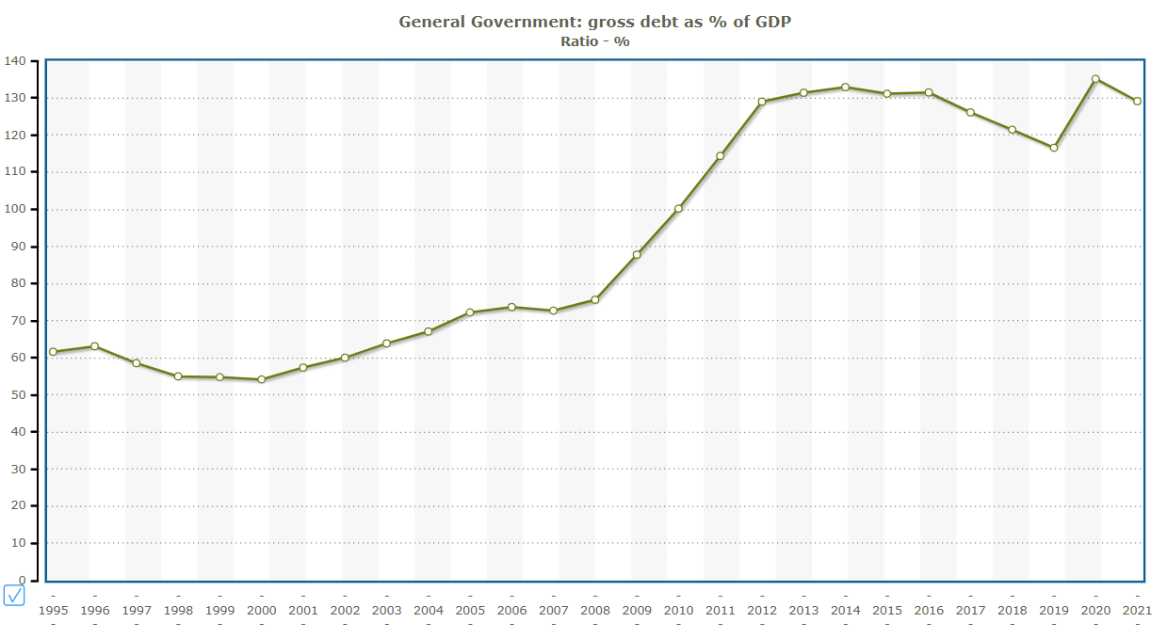
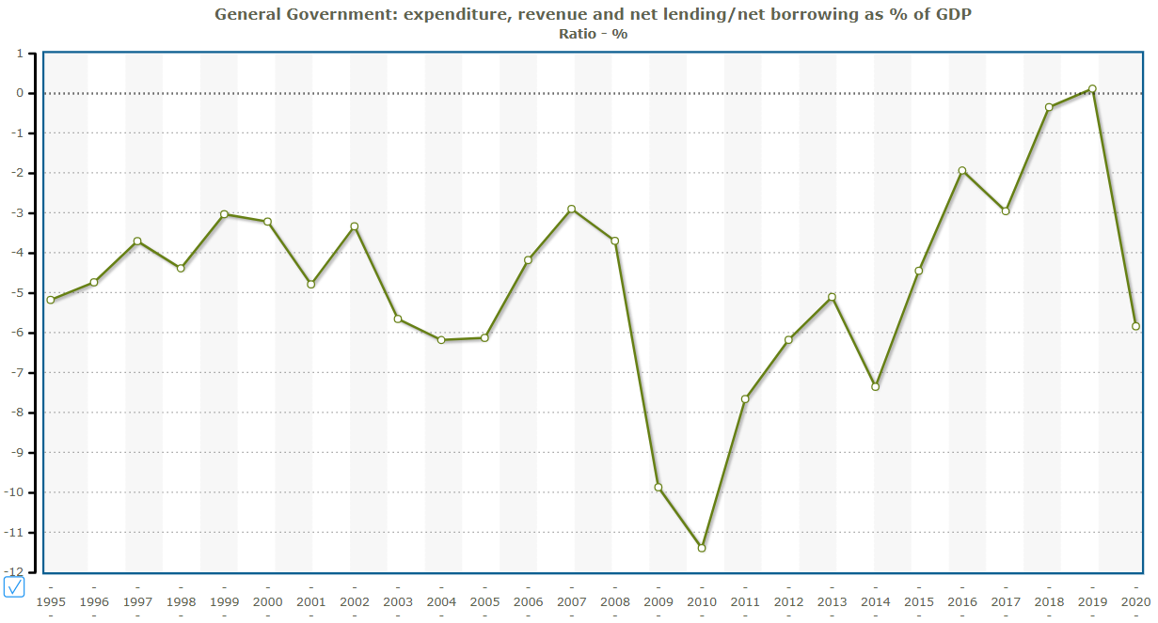
Fiscal balance and public debt as % of GDP, Portugal
Source: pordata.pt

Slide 37
What is the relation between the fiscal balance and public debt?
Deficits (flows) result in stock accumulation and give rise to debt (stock)
Debt needs to be serviced (i.e., payment of interest on debt), which in turn impacts on deficits
It is important to understand the dynamics of public debt accumulation
Noticeably, debt grows faster (debt dynamics) with larger deficits, higher interest rates, or lower economic growth. I.e., countries that grow faster can support larger deficits.

Slide 38
Debt dynamics of US and France
Faster growth of US leads to lower debt growth.

Slide 39
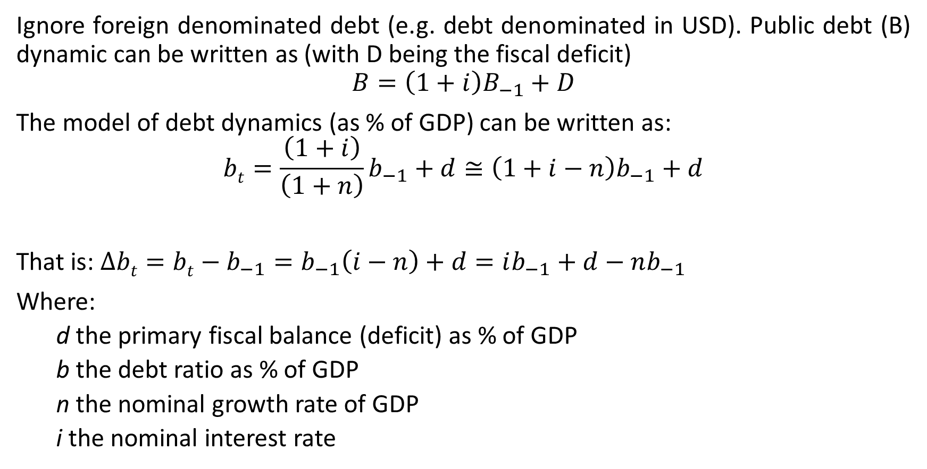
What is the relation between the fiscal balance and public debt?
Ignore foreign denominated debt (e.g. debt denominated in USD). Public debt (B) dynamic can be written as (with D being the fiscal deficit)
$$B=\left(1+i\right)B_{−1}+D$$
The model of debt dynamics (as % of GDP) can be written as:
$$bt=\frac{\left(1+i\right)}{\left(1+n\right)}b_{−1}+d≅\left(1+i−n\right)b_{−1}+d$$
That is: $∆bt=bt−b_{−1}=b_{−1}\left(i−n\right)+d=ib_{−1}+d−nb_{−1}$
Where:
  d the primary fiscal balance (deficit) as % of GDP
  b the debt ratio as % of GDP
  n the nominal growth rate of GDP
  i the nominal interest rate

Slide 40
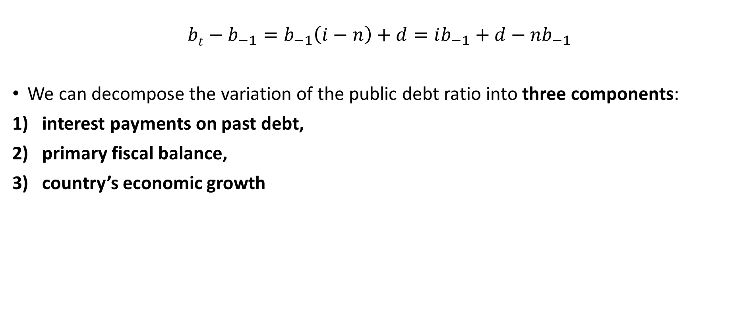
Public debt dynamics
1
2
3
$$bt−b_{−1}=b_{−1}\left(i−n\right)+d=ib_{−1}+d−nb_{−1}$$
We can decompose the variation of the public debt ratio into three components:
interest payments on past debt,
primary fiscal balance,
country’s economic growth

Slide 41
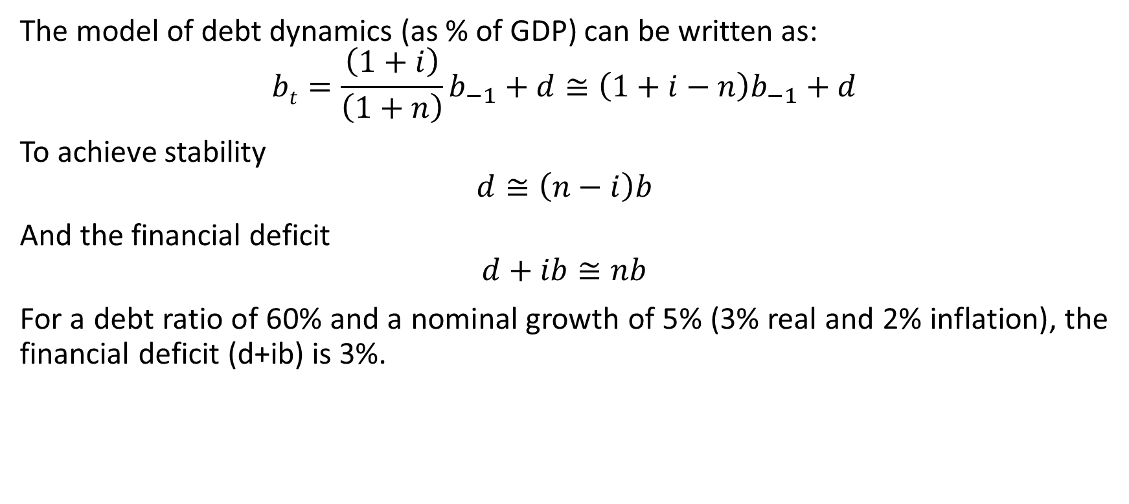
Stabilization
The model of debt dynamics (as % of GDP) can be written as:
$$bt=\frac{\left(1+i\right)}{\left(1+n\right)}b_{−1}+d≅\left(1+i−n\right)b_{−1}+d$$
To achieve stability
$$d≅\left(n−i\right)b$$
And the financial deficit
$$d+ib≅nb$$
For a debt ratio of 60% and a nominal growth of 5% (3% real and 2% inflation), the financial deficit (d+ib) is 3%.

Slide 42
High public debt is more problematic in some countries than others (How much should we care about public debt?)
Why? Because the capacity of the government to raise taxes broadly depends on nominal GDP (this is why public debt is generally measured as a ratio to GDP)
We have seen that the same primary deficit leads to faster debt accumulation the higher the interest rate and the lower the GDP growth rate:
  i<n: When the growth rate n is higher than the interest rate i, a country can stabilize its public debt ratio b, even while maintaining a permanent primary deficit
  i>n: When the interest rate i is higher than the growth rate n, there must be a primary surplus to stabilize the ratio of public debt to GDP b

Slide 43
High public debt is more problematic in some countries than others
Furthermore, the same public debt level may not have the same meaning depending on what the borrowing resources are used for (“All debt is not created equal”)
For example, financing new infrastructure may not worsen the long-term fiscal position of the government for two reasons:
additional infrastructure may raise GDP growth and curb the future debt ratio,
public assets can be sold to reduce debt (one-offs)
Reason 2) suggests that another way to assess public debt is to compare it with public assets, pointing to the difference between net public debt vs. gross public debt (net gov’t debt = gross gov’t debt – financial value of public assets)

Slide 44
Net public debt is the difference between the gross public debt measured at market value and the value of public assets
The net public debt is generally much lower than the gross public debt
It is sometimes even negative, meaning that public assets exceed public debts
The use of net public debt is debatable because a number of public assets cannot be sold. They can give an excessively favorable image of government’s financial situation.
We should also be aware of off-balance liabilities (e.g. pension rights), making debt tricky to calculate.

Slide 45
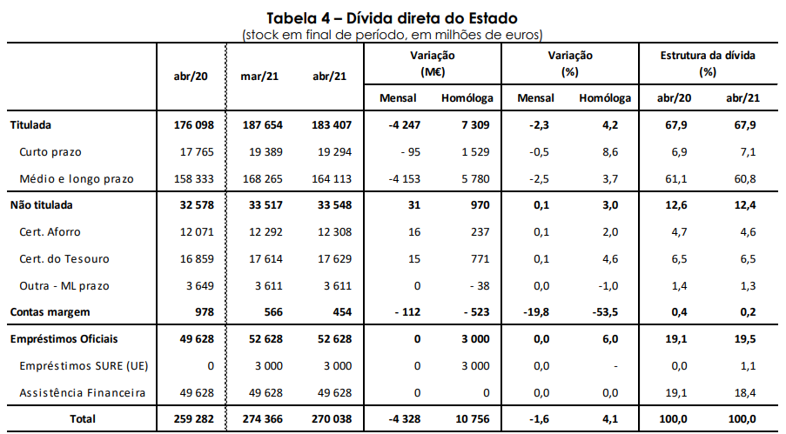
Public debt composition by financing mechanism (million eur), Portugal
68% - Treasury bonds (national & international institutional buyers)
13% - Treasury Bills (e.g., households)
19% - Official loans (e.g., SURE loans (EU); RRF loans (EU); Economic and Financial Assistance Programme (EFAP); European financial stability mechanism (EFSF); European financial stability facility (EFSM); IMF)
Source: Relatório UTAO n.º 11/2021 Condições dos mercados, dívida pública e dívida externa: maio de 2021. Coleção: Acompanhamento da dívida pública e do financiamento da economia. 22 de junho de 2021.
Notes:
https://www.igcp.pt/pt/perguntas-frequentes/

Slide 46
Composition of official loans (19% of all public debt in 2021)
*COVID19 support
** post-programme surveillance (PPS), since 2014, until at least 75% of the financial assistance received by has been repaid. PPS is expected to last until 2035. The objective of PPS is to measure Portugal's capacity to repay its outstanding loans to the European financial stability mechanism (EFSM) and European financial stability facility (EFSF).

Slide 47
Effectiveness
Can we conclude that fiscal expansions are effective or ineffective?
Correlation is not causation.
Too many problems. Very difficult challenge to measure effectiveness.
Popular methods: Macroeconometric, DSGE, and Strutural VAR models.
Empirical results (VARs) find multipliers ranging from less than zero to over four.

Slide 48
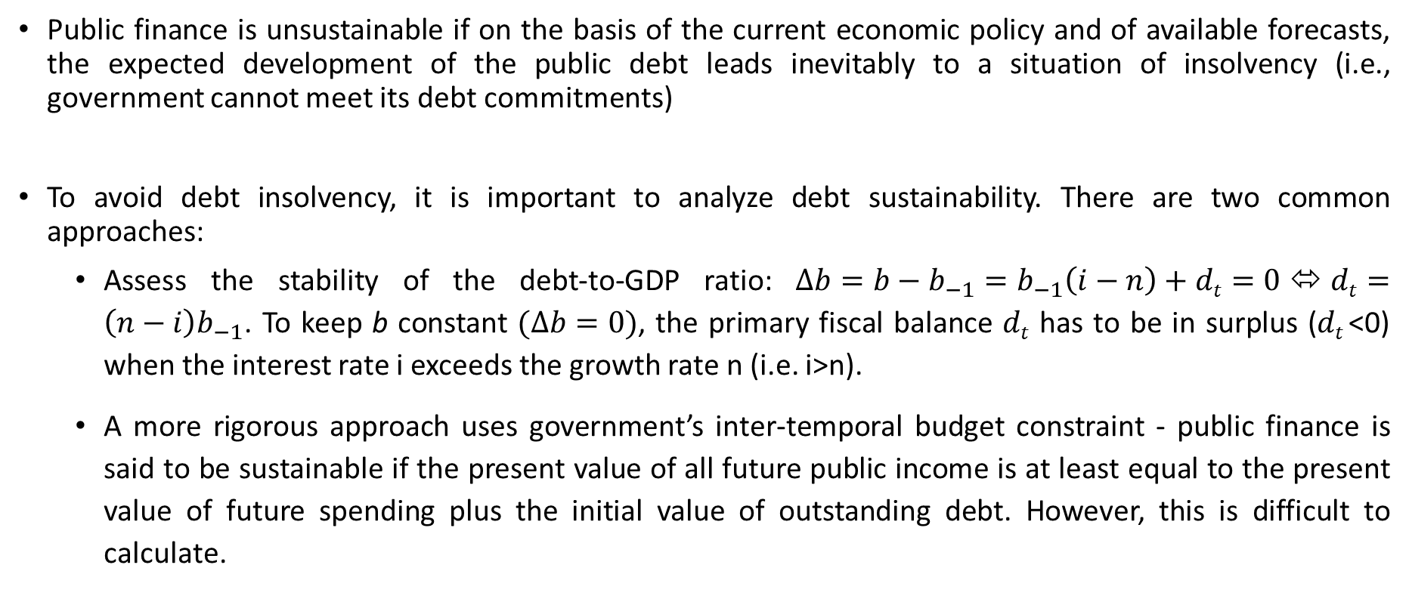
Public debt sustainability
Public finance is unsustainable if on the basis of the current economic policy and of available forecasts, the expected development of the public debt leads inevitably to a situation of insolvency (i.e., government cannot meet its debt commitments)
To avoid debt insolvency, it is important to analyze debt sustainability. There are two common approaches:
  Assess the stability of the debt-to-GDP ratio: $∆b=b−b_{−1}=b_{−1}\left(i−n\right)+dt=0$⬄$dt=\left(n−i\right)b_{−1}$. To keep b constant $(∆b=0)$, the primary fiscal balance $dt$ has to be in surplus ($dt$<0) when the interest rate i exceeds the growth rate n (i.e. i>n).
  A more rigorous approach uses government’s inter-temporal budget constraint - public finance is said to be sustainable if the present value of all future public income is at least equal to the present value of future spending plus the initial value of outstanding debt. However, this is difficult to calculate.
Recommended short reading: https://www.brookings.edu/opinions/a-balance-sheet-approach-to-fiscal-policy/

Slide 49
Public debt sustainability
Solvency: the availability of resources allowing government to meet its debt commitments
In principle, debt can always be serviced through additional taxation and/or reduction of spending, but this can raise political, social and moral issues if households are hurt to degrees considered unacceptable. There are also issues of inter-temporal justice
In general, there is no collateral for sovereign debt. Thus, assessing the solvency of a state requires an evaluation of its willingness to pay
Furthermore, there is a risk that a government defaults even though it is solvent – this is known as a liquidity crisis

Slide 50
Public debt sustainability in a monetary union
A country in an insolvency situation has three options (excluding monetization of public debt which is off limits for a member state):
  massive adjustment combining cuts to primary expenditures and tax increases
  temporary support by other member states and the International Monetary Fund
  partial default whereby the government negotiates a debt reduction with its creditors
  In most cases, solvency crisis are generally solved by a combination of all three options.

Slide 51
Policy coordination in a Monetary Union
Economic theory provides arguments against coordination: For example, the Mundell–Fleming model, under flexible exchange rates and perfect capital mobility (assumptions adapted to the situation of the euro area as a whole) leads to the conclusion that fiscal policy is ineffective for the Union as a whole; the task of stabilizing the economy of the euro area accordingly falls primarily on monetary policy.
The coordination of fiscal policies to stabilize the activity appears to be a second-best solution ranking below monetary policy, to be used, for example, when the ECB is prevented by a conflict among objectives from providing a needed stimulus or when monetary policy alone cannot stabilize the economy.
Using fiscal policy coordination to counter the action of the ECB could only result in a costly failure.
The deep recession of 2008–09 provided a textbook case for fiscal policy coordination within the euro area:
  The shock was largely symmetric, implying that a common response was in order;
  Monetary policy was rendered ineffective by the state of the banking system, which called for additional budgetary support;
  The central banks were pursuing an accommodative monetary policy, reducing the policy rate to zero.
Yet, the fiscal response in Europe was only loosely coordinated.

Slide 52
Fiscal policy and Demand-side effects: Keynes and his critics
Keynes’s General Theory of Employment, Interest and Money (1936) provided the conceptual framework for the use of fiscal policy to influence the level of aggregate demand
While classical theory was concerned about public finance solvency (debt stock), Keynes’s theory focused on the role of flows of public income and expenditures in the determination of the aggregate macroeconomic equilibrium
However, since debt results from the accumulation of deficits, the outcome of excessive reliance on fiscal policy was an increase in public debt ratios. This fact was ignored in the first three decades after World War II and it was only in reaction to an excessive reliance on fiscal policy in the 1970s to the associated permanent deficits and to the resulting increase in public debt ratios that debt-related concerns appeared
In response to these concerns, economists developed models to represent public debt dynamics and their effects on the economy (as we have discussed previously)

Slide 53
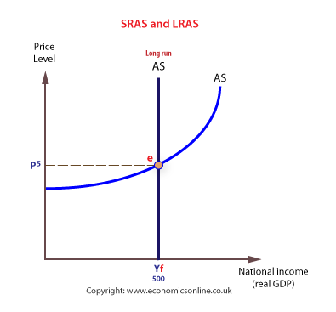
Fiscal policy and Demand-side effects: Keynes and his critics
The Keynesian model assumes prices adjust slowly (price rigidity) and thus adjustment occurs via income level
This is especially the case in the short(er) run when the economy is operating below full capacity (Y_{f}) - and thus there is excess capacity – so increasing AD does not increase prices but increases output
The Keynesian view was a departure from the Classical view of perfect price adjustment and can be used when the economy is operating well below full potential (think Great Depression 1930s)
AD³
AD²
AD¹
Potential output
Notes:
Keynes thought that classical models were not useful during the Great Depression.
In the long run Keynes accepted the perfectly inelastic LRAS, but he also said in the long run we are all dead.

Slide 54
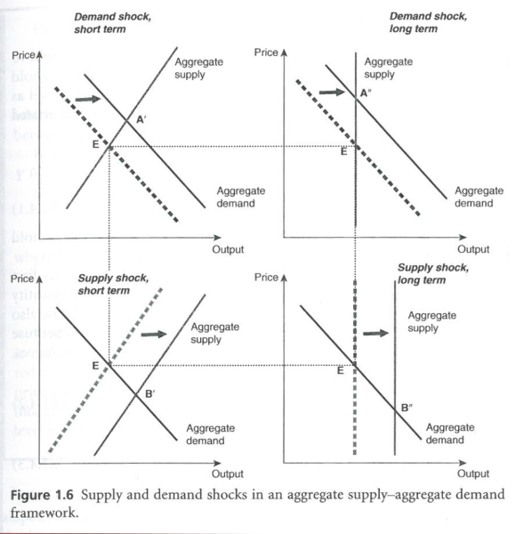
Fiscal policy and Demand-side effects: Keynes and his critics
So: the effectiveness of demand-side policies depends on the slope of the short-run AS curve
In an economy with nominal rigidities and low responsiveness of wages to labour market conditions, the short-run AS curve will be almost flat, making demand policies very effective
In contrast, when prices and wages adjust fast to unemployment, the short-run AS curve is nearly vertical and demand policies are very ineffective
NB. Besides the diff. on assumptions about AS curve, Keynes also had a different view about individuals' behaviour (i.e. animal spirits of households and firms), which further supported the intervention of state to influence economy
AS³
AS¹
AS²

Slide 55
Fiscal policy and Demand-side effects: Keynes and his critics
The main instrument used to assess how government’s use of public spending (G) affects output (Y) by shifting the AD outward is the Keynesian multiplier of government spending: (∆Y/∆G) - the ratio between the output variation ∆Y and the initial exogenous variation of aggregate demand ∆G
There are other Keynesian multipliers (e.g. taxes, investment)

Slide 56
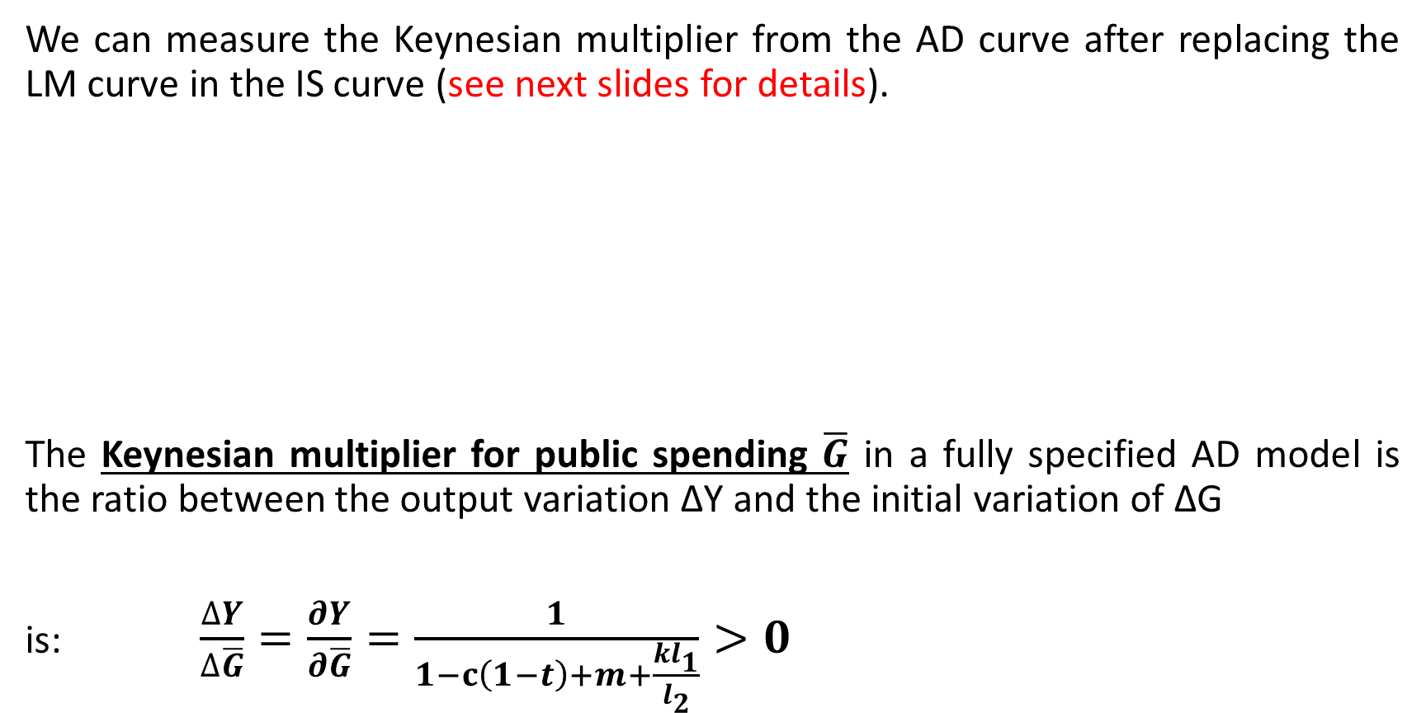
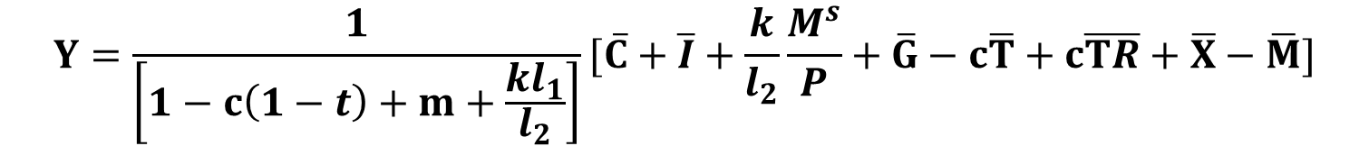
Demand-side effects: Keynes and his critics
We can measure the Keynesian multiplier from the AD curve after replacing the LM curve in the IS curve (see next slides for details).
The Keynesian multiplier for public spending $\overline{G}$ in a fully specified AD model is the ratio between the output variation ∆Y and the initial variation of ∆G
is: $\frac{∆Y}{∆\overline{G}}=\frac{∂Y}{∂\overline{G}}=\frac{1}{1−c\left(1−t\right)+m+\frac{kl_{1}}{l_{2}}}>0$
$$Y=C+I+X−M$$
$$Y=\frac{1}{\left[1−c\left(1−t\right)+m+\frac{kl_{1}}{l_{2}}\right]}[\overline{C}+\overline{I}+\frac{k}{l_{2}}\frac{M^{s}}{P}+\overline{G}−c\overline{T}+c\overline{TR}+\overline{X}−\overline{M}]$$

Slide 57
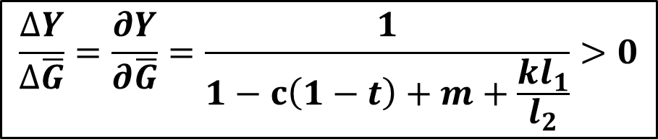
Demand-side effects: Keynes and his critics
Keynesian multiplier - there are many factors that may reduce the size of the multiplier and hence weaken the impact of fiscal expansion (∆G>0) on aggregate demand and income
Which factors do you think may reduce the size of the public spending multiplier?
$$\frac{∆Y}{∆\overline{G}}=\frac{∂Y}{∂\overline{G}}=\frac{1}{1−c\left(1−t\right)+m+\frac{kl_{1}}{l_{2}}}>0$$

Slide 58
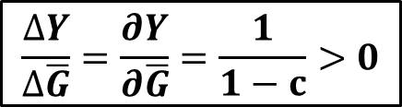
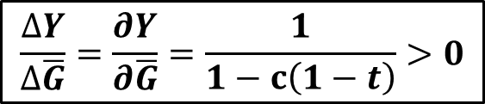
Demand-side effects: Keynes and his critics
Keynesian multiplier - factors that may lower the public spending multiplier and weaken the impact of fiscal expansion:
Taxes reduce disposable income Y^{d} of consumers: increase in tax rate t reduces the multiplier because it reduces ability to spend/consume
$$\frac{∆Y}{∆\overline{G}}=\frac{∂Y}{∂\overline{G}}=\frac{1}{1−c}>0$$
$$\frac{∆Y}{∆\overline{G}}=\frac{∂Y}{∂\overline{G}}=\frac{1}{1−c\left(1−t\right)}>0$$
1
$$C_{}=\overline{C}+cY^{d}=\overline{C}+c\left(Y−T+\overline{TR}\right)=\overline{C}+c\left(Y−(\overline{T}+tY)+\overline{TR}\right)=(\overline{C}−\overline{T}+\overline{TR})+c\left(1−t\right)Y$$

Slide 59
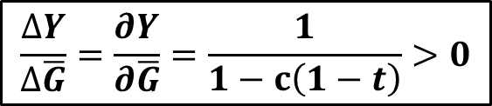
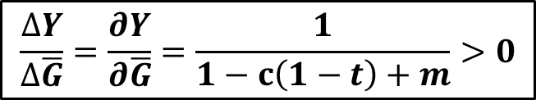
Demand-side effects: Keynes and his critics
Keynesian multiplier - factors that may lower the public spending multiplier and weaken the impact of fiscal expansion:
2. In an open economy, an additional euro of disposable income leads households to consume imported products and firms to import more intermediate goods, reducing the size of the multiplier
$$\frac{∆Y}{∆\overline{G}}=\frac{∂Y}{∂\overline{G}}=\frac{1}{1−c\left(1−t\right)}>0$$
$$\frac{∆Y}{∆\overline{G}}=\frac{∂Y}{∂\overline{G}}=\frac{1}{1−c\left(1−t\right)+m}>0$$
2
$$M_{}=\overline{M}+mY$$

Slide 60
Demand-side effects: Keynes and his critics
Keynesian multiplier - factors that may lower the public spending multiplier and weaken the impact of fiscal expansion:
3. Assumption of complete price rigidity is extreme. If prices adjust upward, part of the increase in aggregate demand is not due to an increase of the volume of products consumed but their price
4. Crowding-out effect: increase in aggregate demand can be offset by lower private investment as a response to increase in interest rate.
Both 3 and 4 point to the fact that including the money market (LM curve) leads to a reduction of the Keynesian multiplier and the reduction will be larger the greater the increase in the interest rate r and the demand for money

Slide 61

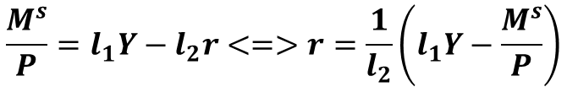
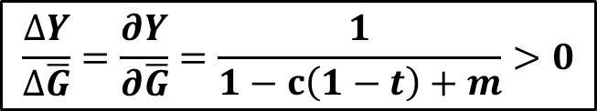
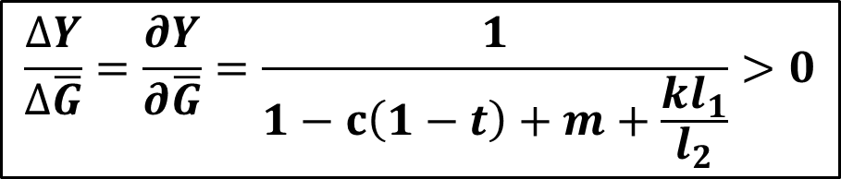
Demand-side effects: Keynes and his critics
Keynesian multiplier - factors that may lower the multiplier and weaken the impact of fiscal expansion:
$$\frac{∆Y}{∆\overline{G}}=\frac{∂Y}{∂\overline{G}}=\frac{1}{1−c\left(1−t\right)+m+\frac{kl_{1}}{l_{2}}}>0$$
$$\frac{∆Y}{∆\overline{G}}=\frac{∂Y}{∂\overline{G}}=\frac{1}{1−c\left(1−t\right)+m}>0$$
3, 4
$$\frac{M^{s}}{P}=l_{1}Y−l_{2}r<=>r=\frac{1}{l_{2}}\left(l_{1}Y−\frac{M^{s}}{P}\right)$$
$$I=\overline{I}−kr$$

Slide 62
Demand-side effects: Keynes and his critics
Keynesian multiplier and the Mundell-Fleming Model of an open-economy
The Mundell-Fleming model studies policy effectiveness in a small country under perfect capital mobility and under the Keynesian assumption of underemployment of resources
Perfect capital mobility implies that the interest rate cannot deviate from the world interest rate, otherwise capital would flow in or out in search of yield/higher return. Depending on the exchange rate regime (flexible vs. fixed), the effect of fiscal policy will be more or less effective – see diagrams in next slide and table
In a flexible exchange rate regime, the Keynesian multiplier is reduced due to the appreciation of domestic currency following the increase in interest rate due to the fiscal expansion (outward shift of IS). Thus, fiscal expansionary policy is less effective compared to fixed exchange rate regime where the govt/CB can sell domestic currency (which shifts LM downward) following appreciation due to increase in interest rate following expansionary fiscal policy (outward shift of IS) to ensure fixed exchange rate.

Slide 63
Fiscal expansion under flexible exchange rates
Fiscal expansion under fixed exchange rates
Short-term effectiveness of fiscal policy in an open economy
 | High capital mobility | Low capital mobility
Flexible exchanges rates | Ineffective or not so effective | Effective
Fixed exchange rates | Effective | Not very effective

Slide 64
Main neoclassical critics to using à la Keynes expansionary fiscal policy as a response to economic crisis
The neoclassical critique of the Keynesian multiplier:
Full financial crowding-out
Supply rigidity
Ricardian equivalence

Slide 65
Full financial crowding-out:
After a fiscal expansion (e.g. ↗G), the increase in demand for money leads to increase in interest rate i, which reduces private investment (i.e. ↘I). In the AD-AS model, the AD curve does not move (or moves little) in the event of a fiscal shock: output level is not affected, but its composition is modified by the substitution of public demand G for private demand I.
P
AS
P¹
P²=P⁰
AD¹
Partial crowding-out:
AD=AD²
P
Y⁰=Y²
Y¹
AS
Y
P¹
AD⁰ | I⁰, G⁰
AD¹ | I¹=I⁰, G¹>G⁰
AD² | I²<I¹, G²=G¹ and ∆G=-∆I
P²
P⁰
AD¹
AD²
AD
Y⁰
Y²
Y¹
Y
Notes:
Crowding out means decrease in Investment due to increase in interest rate brought by an expansionary fiscal policy; that is, increase in Government expenditure.
Whether crowding out takes place or not will depend on the slope of LM curve.
(a) If LM curve is positively sloped → Partial crowding will take place (Fig. 11.8)
(b) If LM curve is horizontal → No crowding out takes place (Fig. 11.9)
(c) If LM curve is vertical → Full crowding out takes place (Fig. 11.10)

Slide 66
2. Supply rigidity:
AS³
The relative price adjustment is sufficiently rapid so that the goods-market equilibrium is determined by supply
In the AD-AS model, the AD curve moves toward the right but the AS curve is very steep and almost vertical: Producers agree to slightly increase supply only if prices increase a lot. Private demand is penalized ex-post by the rise in prices.
AS¹
AS²

Slide 67
3. Ricardian equivalence:
Neoclassical argument used (e.g. Robert Barro) to show that an expansionary FP (e.g. ↗G) would be ineffective as a response to an economic crisis because the resulting public deficit would lead to reduced private consumption (↘C).
The “equivalence” refers to the fact that it is indifferent to finance the public deficit with public debt (i.e. future taxation) or immediate taxation, because the outcome is the same: a reduction in current level of private consumption by hhs.
The argument relies on the rational expectations hypothesis to say that households respond to an increase in public spending (↗G) or tax cut (↘T) by restricting their current consumption C, instead of increasing it, because they expect that the public deficit will translate into higher future taxes and so prepare for it by increasing their savings and hence reduce consumption. That is, consumers save the additional income today to pay for expected future higher taxes.

Slide 68
3. Ricardian equivalence:
The Ricardian equivalence rests on very strong hypotheses, which often don’t hold:
Rational expectations of households (able to “see through” the effect of the short-term fiscal expansion and anticipate future taxes). (plus, hhs may want to use savings to buy public debt)
Fiscal expansion is assumed to be unproductive, which is likely untrue since public expenditure in research, education, public infrastructure are expected to increase productivity.
Perfect functioning of the credit markets: credit constrained consumers facing higher borrowing costs will prefer to spend the additional income so ∆S=0, so there is no crowding-out
Infinitely lived households who treat the well-being of the forthcoming generations in the same way as they treat their own. Real households, however, are mortal, and do not care about future generations as much as they care about themselves or their own children

Slide 69
Supply-side effects and reconciliation attempts
We saw that fiscal policy affects output through shifts to the AD curve in the short run and this effect can be measured by the Keynesian multiplier
The magnitude of the Keynesian multiplier is affected by several factors including the marginal propensity to consume c, marginal propensity to import m, taxes t, etc.
The neoclassical critics of the Keynesian multiplier also presented reasons for its ineffectiveness (e.g. crowding-out, Ricardian equivalence, supply rigidity)
These issues raised doubts about the effectiveness of FP and help understand the shift to supply-side policies during the 80s and 90s. During these periods FP was mostly concerned with public finance sustainability while tax cuts were still seen as affecting output positively

Slide 70
Supply-side effects and reconciliation attempts
Tax cuts: Both neoclassical and Keynesians models recommend tax cuts to stimulate economic growth, but the neoclassical view is that tax cuts stimulate supply and can raise potential output, while for the Keynesian models it boosts demand through induced rise in disposable income
Public spending: In full disagreement with Keynesian models, neoclassical models deny any positive short-run effect of public spending while emphasizing its implications in terms of future rises in taxes which, if rationally anticipated, have a negative short-term impact on consumption (Ricardian equivalence). They advocate for cuts to public spending to ensure lower taxation in future and thus stronger long-term growth

Slide 71
Supply-side effects and reconciliation attempts
Neoclassical models generally deny any significant impact of counter-cyclical fiscal policies
However, they underline the usefulness of tax cuts to increase aggregate supply and raise potential output
In the AD-AS model, a tax cut moves the supply curve downward, increasing output and reducing prices

Slide 72
Supply side & Reconciliation attempts
Models explaining alternative outcomes | Hypothesis | Mechanisms | Effect of a fiscal contraction
Neo-Keynesian models | Short-medium-term horizon. Flexible supply conditions. | Partial financial crowding-out. Absence of nonlinearities. KEYNESIAN | Recessionary
Ricardian equivalence | Intertemporal budget constraint. Consumers with infinite horizon. Rational expectations. | Crowding-out one for one of private consumption by public consumption. Neutrality of the deficit. NON-KEYNESIAN | Neutral/no effect
Neoclassical models with composition effects | Neo-Ricardian framework. Fiscal distortions. The composition of the adjustment depends on the initial conditions (debt levels ...) | Super-crowding-out due to supply-side effects. ANTI-KEYNESIAN | Expansionary (if poor initial conditions, i.e. high debt) – expansionary fiscal contraction
Keynesian models with threshold effects | Keynesian rigidities. Consumers with finite horizon. Probability of “stabilization” programme grows with the debt | Accumulation of public debt is main mechanism. Keynesian mechanisms under standard conditions. Inversion of effects under poor public finance. KEYNESIAN OR ANTI-KEYNESIAN | Recessionary if debt is low. Expansionary if debt is high.
Effect of a restrictive fiscal policy within various theoretical frameworks
Policy | Effect of policy | Mechanism at work
Fiscal contraction (↘G, ↗T) | Expansionary | Anti-keynesian
 | No effect | Non-keynesian
 | Recessionary | Keynesian

Slide 73
The example of the 2008-09 crisis
Recognition that the conditions that are required for fiscal policy to be effective were likely to be met:
The world economy was hit by a major demand shock, resulting in a strongly negative global output gap and significant risks of deflation. So, the aggregate supply curve could be expected to be flat.
World long-term interest rates were very low and with near-zero policy rates, global monetary policy was strongly accommodative. So, there was no crowding effect to talk of.
The share of credit-constrained households and firms had increased as a result of lower bank willingness to lend. Hence, pouring public cash into them had a higher probability to raise demand than in normal times.
The stimulus was coordinated or at least simultaneous the world over. So the ineffectiveness of fiscal expansion in a floating exchange-rate regime did not hold.

Slide 74
Conclusion
All in all these models have now been subject to intense research without any convergent view on the impact of fiscal policy.
This is perhaps because these models ignore heterogeneity of agents’ response. Particularly, they ignore the heterogeneity of producers.
More recent models with heterogeneous agents can pretty much deliver anything (e.g. HANK – heterogenous agents new Keynesian models). The issue is now one of quantification that emerges as quantitative-macro exercises.

